Slide 1
FRESCOM Login Process on New Server

Slide 2
FRESCOM under Single Logon HR Tools
FRESCOM is moved under HR tools. This is single logon assess using your signum & password used for laptop login
Type below URL in the browser and follow the steps to login to GINA HR Tools
After login to GINA HR Tools you will again use the same below URL to login to FRESCOM
http://hrtools.india.ericsson.net/frescom

Slide 3
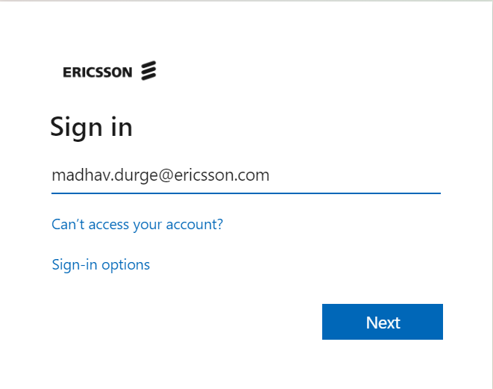

Slide 4
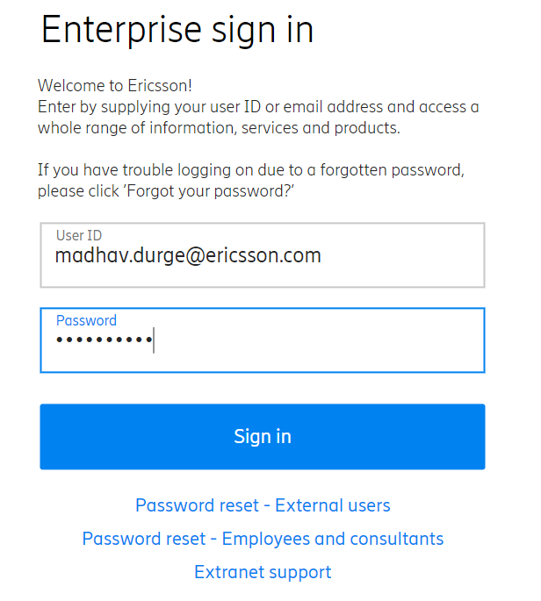

Slide 5
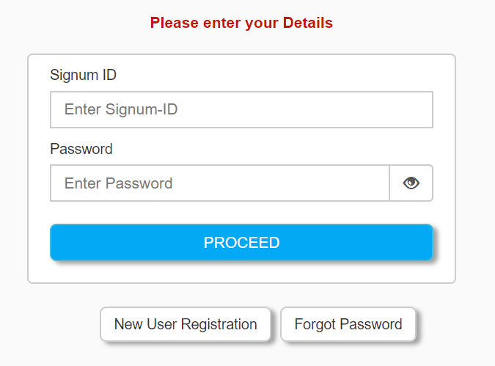
Click Forgot Password…or use your laptop login password (current or previous)

Slide 6
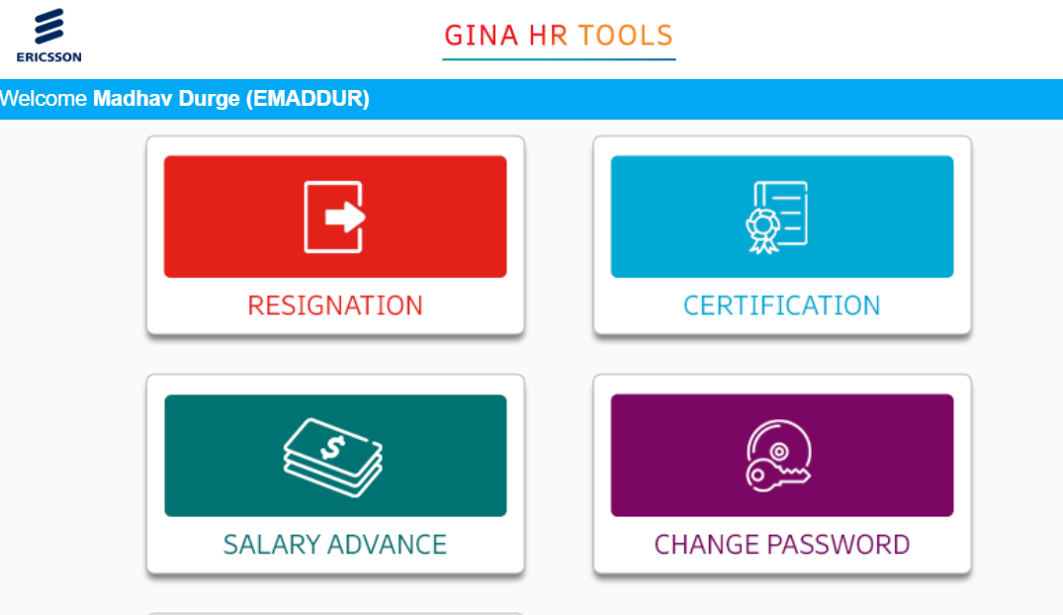
No FRESCOM icon under HR Tools….Don’t Logout

Slide 7
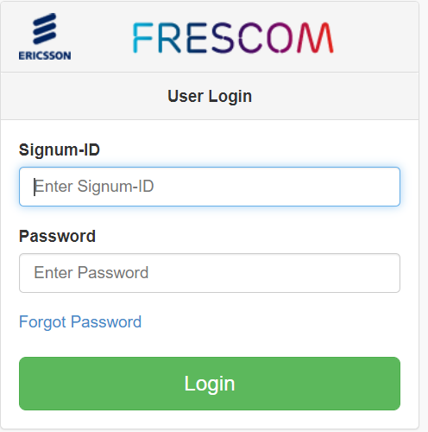
Use below URL to go to FRESCOM site
http://hrtools.india.ericsson.net/frescom

